Slide 1
Electricity prices prediction
proj_220066_team_1

Slide 2
1. Introduction
Briefly introduce the concept of electricity price prediction.
Highlight the importance of accurate price predictions in the energy sector.

Slide 3
2. Futures
Discuss the methods and technologies used in electricity price prediction.
Explain the role of historical data, machine learning, and statistical models.

Slide 4
#Execute in the main block
#Convert the Date column into a date object
electricity_df [ 'Date']=pd.to_da
tetime(electricity_df[ 'Date'])
#Set Date as a Pandas
DatetimeIndex
electricity_df. index-pd.Datetim
eIndex(electricity_df['Date']) #Decompose the time series into
parts
decompose_time_series (electricity_df['Electricity_Price']

Slide 5
EXECUTIVE SUMMARY

Slide 6
GLOBAL OVERVIEW
us

Slide 7
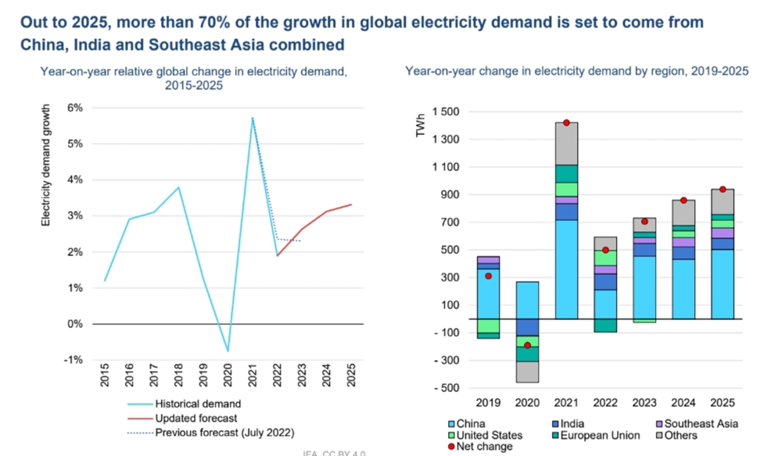

Slide 8
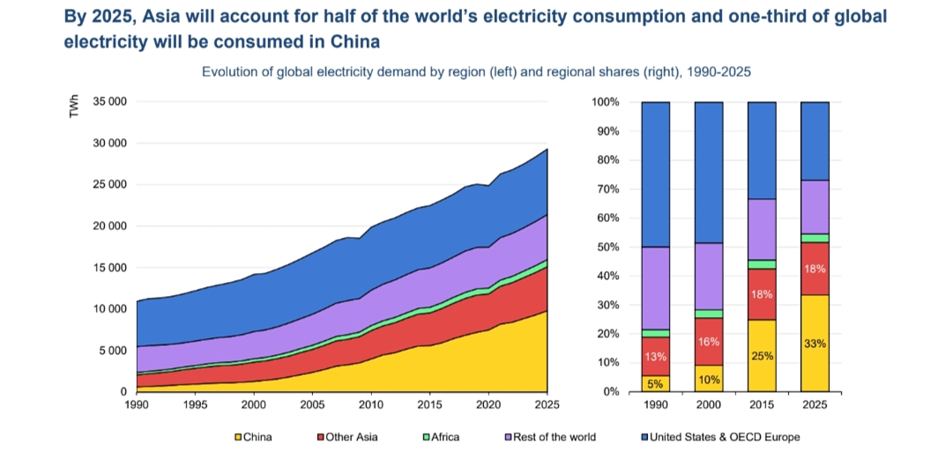

Slide 9
3. Uses
Describe the various applications of electricity price prediction:
Energy market trading and investment decisions.
Energy consumption optimization for consumers.
Grid management and capacity planning for utilities.

Slide 10
4. Value
Explain the value of accurate price predictions in the electricity sector:
Improved cost management for energy companies.
Better resource allocation and infrastructure planning.
Enhanced competitiveness in energy markets

Slide 11
5. Vision
Discuss the broader vision for electricity price prediction:
Advancements in predictive analytics and AI.
Integration with renewable energy sources and smart grids.
Contribution to a more sustainable and efficient energy future.

Slide 12
6. Mission
Outline the mission and goals related to electricity price prediction:
Enhancing predictive accuracy and reliability.
Promoting transparency and fairness in energy markets.
Facilitating the transition to cleaner and more sustainable energy sources.

Slide 13
7. Advantages
Highlight the advantages of electricity price prediction:
Informed decision-making for businesses and consumers.
Reduced operational costs for utilities.
Improved grid stability and resilience.

Slide 14
8. Disadvantages
Acknowledge the potential disadvantages and challenges:
Uncertainties due to external factors (e.g., weather events).
Ethical concerns regarding data privacy and market manipulation.
Technological limitations and model inaccuracies.

